Slide 1
Machine Learning
Machine Learning is a growing technology which enables computers to learn automatically from past data. Machine learning uses various algorithms for building mathematical models and making predictions using historical data or information. Currently, it is being used for various tasks such as image recognition, speech recognition, email filtering, Facebook auto tagging, recommender system, and many more.
introduction to machine learning along with the wide range of machine learning techniques such as Supervised, Unsupervised, Semi supervised, reinforcement learning. You will learn about regression and classification models, clustering methods, hidden Markov models, and various sequential models

Slide 2
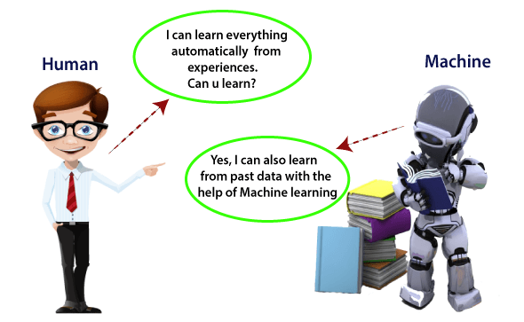
Machine Learning
What is machine learning
Machine Learning(ML) is a type of artificial intelligence(AI)that allows software applications to become more accurate at predicting outcomes without being explicitly programmed to do so. Machine Learning algorithms use historical data as input to predict new output values.

Slide 3
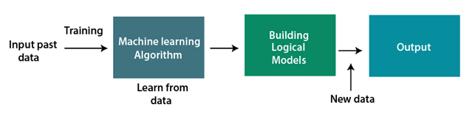
How does Machine Learning work
A Machine Learning system learns from historical data , builds the prediction models, and whenever it receives new data, predicts the output for it. The accuracy of predicted out put depends upon the amount of data, as the huge amount helps to build a better model which predicts the output more accurately

Slide 4
Features of Machine Learning
Machine learning use data to detect various patterns in a given data set.
It can learn from past data and improve automatically
It is a data-driven technology.
Machine learning is much similar to data mining as it also deals with the huge amount of the data

Slide 5
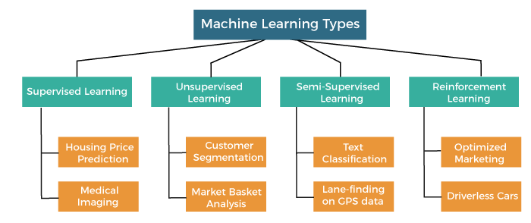
Classification of Machine Learning
machine learning can be classified into four types:
Supervised Learning
Unsupervised Learning
Semi supervised Learning
Reinforcement Learning
Supervised Learning
Supervised learning is a type of using machine learning method in which we provide sample labeled data to data to the machine learning system in order to train it, and on that basis, it predict the output.
The system creates a model using labeled data to understand the datasets and learn about each data, once the training and processing are done then we test the model by providing a sample data to check whether it is predicting the exact output or not.
The supervised learning is based on supervision, and it is the same as when a student learns thing in the supervision of the teacher . The example of Supervised learning is spam filtering.
Supervised learning can be grouped further in two categories of algorithms
Classification
Regression

Slide 6
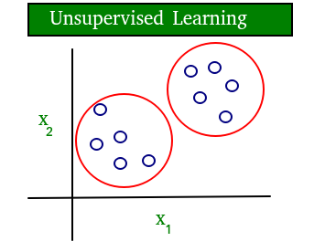
2. Unsupervised Learning.
The training is provided to the machine with set of data that has not been labeled, classified, or categorized, and the algorithm needs to act on that data without any supervision. The goal of unsupervised learning is to restructure the input data into new feature or a group of objects with similar patterns.
In unsupervised learning, we don’t have a predetermined result. The machine tries to find useful insights from the huge amount of data. It can be further classifieds into two categories of algorithms,
Types of unsupervised:
Clustering
Association

Slide 7
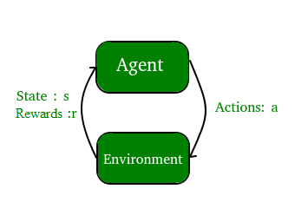
Reinforcement Learning
Reinforcement learning is a feedback-based learning method, in which a learning agent
Gets a reward for each right action and gets a penalty for each wrong action . The agent learns automatically with these feedbacks and improves and explores it. The goal of an agent is to get the most reward point, and hence, it improves its performance.
The robotic dog, which automatically learns the movement of his arms, is an example of reinforcement learning.

Slide 8
Semi-Supervised Learning
Semi-Supervised learning is a combination of supervised and unsupervised machine learning methods. With more common supervised machine learning methods, you train a machine learning algorithm on a labeled dataset in which each record includes the outcome information.

Slide 9
Central Processing Units(CPU):
CPU is a device primarily known as the brain for every embedded system. It comprises the arithmetic logic unit(ALU)which stores the information , performs calculations and control unit(CU)which performs instructions and branching . CPU interacts with more computer components such as memory, input , and output for performing instruction.
The input/output interface is sometimes included in the control limit. The CPU assigns more hardware unit to fast cache low to computation, unlike GPU.
Graphics Processing Unit(GPU):
GPU is used to enhance the images , videos, of the computer games . It is typically incorporated with CPU for sharing RAM with CPU WHICH is good for the most computing task. The discrete GPU unit contain its own RAM is known as VRAM for videos RAM. The GPU can achieve a high speed comparative of the CPPU because of its immense parallel processing.

Slide 10
Differences between CPU and GPU
S.NO | CPU | GPU
1 | CPU stands for central processing unit. | GPU stands for graphics processing
2 | CPU requires more memory than GPU | CPU memory requirement are low
3 | CPU focuses on low latency. | GPU focuses on high throughout
4 | CPU speed is less than GPU | GPU is faster than CPU
5 | CPU suits more for serial instruction processing | GPU is not suitable for parallel instruction processing
6 | CPU is not suitable for parallel instruction processing | GPU suits more for parallel instruction processing.
7 | CPU contain minute powerful cores. | While it contains more weak cores

